Slide 1

PREDICTING HOUSE PRICE USING MACHINE LEARNING
PROJECT : HOUSE PRICE PREDICTION

Slide 2

House Price Prediction
Introduction:
Whether you’re a homeowner looking to estimate the value of your property,a real estate investor
Seeking profitable opportunities,or a data scientist aiming to built a predictive model,the foundation
Of this endeavor lies in loading and preprocessing the dataset.
Building a house price prediction model is a data-driven process that involves harnessing the power of machine learning to analize historical housing data and make informed price predictions.this journey begins with the fundamental steps of data loading and preprocessing.
This introduction will guide you through the initial steps of the process.we’ll explore how to import essential libraries,load the housing dataset,and perform critical preprocessing steps.Data preprocessing is crucial as it helps clean,format and prepare the data for further analysis.This includes handling missing values,encoding categorical variable,and ensuring that thedata is appropriately scaled.

Slide 3
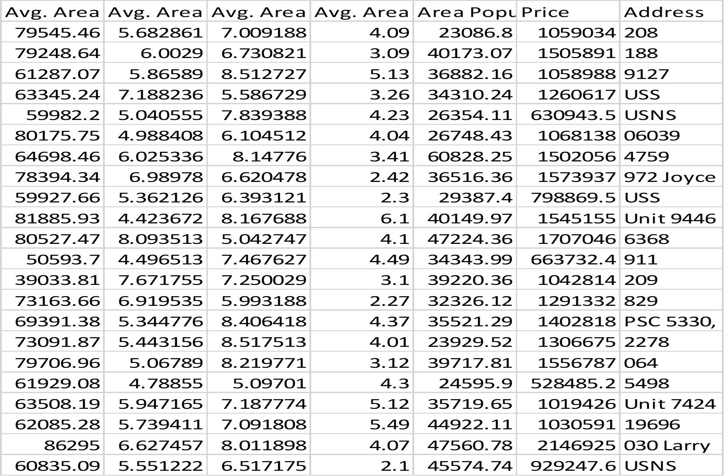
Given Data Set:

Slide 4
Necessary Steps to Follow:
1)Import Necessary Libraries
Start by importing the necessary libraries
import pandas as pd
import numpy as np
from sklearn.model_selection import train_test_split
from sklearn.preprocessing import StandardScaler
2)Load the Dataset
Load your dataset into a Pandas DataFrame.You can typically find house price datasets in CSV format,but you can adapt this code to other formats as needed.
Program:
df=pd.read_csv(‘E:\USA_Housing.csv’)
pd.read()
3)Exploratory Data Analysis(EDA):
Perform EDA to understand your data better.This includes checking for missing values,exploring the data’s statistics,and visualizing it to identify patterns.
Program:
#Check for missing values
Print(df.isnull().sum())

Slide 5
#Explore statistics
Print(df.describe())
#Visualize the data(e.g.,histograms,scatter plots,etc.)
4)Feature Engineering:
Depending on your dataset,you may need to crate new features or transform existing ones.This can involve one-hot encoding categorical variables,handling date/time data,or scaling numerical features.
Program:
#Example:One-hot encoding for categorical variables
df=pd.get_dummies(df,columns=[‘Avg.Area Income’,’Avg.Area Housing Age;])
5)Split the Data:
Split your dataset into training and testing sets.This helps you evaluate your model’s performance later.
X = df.drop(‘price', axis=1) # Features
y = df[‘price'] # Target variable
X_train, X_test, y_train, y_test = train_test_split(X, y, test_size=0.2, random_state=42)

Slide 6
6)Feature Scaling:
Apply feature scaling to normalize your data,ensuring that all features have similar scales.Standardization(scaling to mean=0 and std=1)is a common choice.
Program:
scaler=StandardScaler()
X_train=scaler.fit_transform(X_train)
X_test=scaler.transform(X_test)
Importance of loading and processing dataset:
Loading and preprocessing the dataset is an important first step in building any machine learning model.However,it is especially impotant for housing price prediction models,as house price datasetsare often complex and noisy.
By loading and preprocessing the dataset,we can ensure that the machine learning algorithm is able to learn from the data effectively and accurately.
Challenges involved in loading and preprocessing a house price dataset:
There are a number of challenges involved in loading and preprocessing a house price dataset,including:
Handling missing values:
House price datasets often contain missing values,which can be due to a variety of factors.such as human error or incomplete data collecton.Common methods for handling missing values include dropping the rows with missing values,imputing the missing

Slide 7


Values,imputing the missing values with the mean or median of the feature,or using a sophisticated method such as multiple imputing.
Encoding categorical variables:
Housing price datasets often contain categorical features,such as the type of housing,the neighborhood,and the school district.These features need to be encoded before theycan be used by machine learning models.One common way to encode categorical variables is to use One-hot encoding.
Scaling the features:
It is often helpful to scale the features before training a machine learning model.This ca help to improve the performance of the model and make it more robust to outliers.There are a variety of ways to scale the features,such as mim-max scaling and standard scaling. Splitting the dataset into training and testing sets:
Once the data has been pre-processed,we need to split the dataset into training and testing sets.The training set will be used to evaluate the the performance of the model on unseen data.It is important to split the dataset in a way that is representative of the real world distribution of the data
How to overcome the challenges of loading and preprocessing a house price dataset:
There are a number of things that can be done to overcome the challenges of loading and preprocessing a house price dataset.includind

Slide 8

Use a data preprocessing library:
There are a number of libraries available that can help with data preprocessing tasks,such as handling missing values,encoding categorical variables,and scaling the features.
Carefully consider the specific needs of your model:
The best way to preprocess the data will depend on the specific machine learning algorithm that you are using.It is important to carefully consider the requirements of the algorithm and to preprocess the data in a way that is compatible with the algorithm.
Validate the preprocessed data:
It is important to validate the preprocessed data to ensure that it is in a format that can be used by the machine learning algorithm and tht it is of high quality.This can be done by inspecting the data visually or by using statistical methods.
1.Loading the dataset:
Loading the dataset using machine learing is the process of bringing the data into the machine learning environment so that it can be used to train anf evaluate a model
The specific steps involved in loading the dataset will vary depending on the machine learning library or framework that is being used. However,that are some general steps that
Are common to most machine learning framework:

Slide 9

a)Identify the dataset:
The first step is to identify the dataset that you want to load.This dataset may be stored in a local file, in a database,or in a cloud storage service.
b)Load the dataset:
Once you have identified the dataset,you need to lead it into the machine learning environment.This may involve using a built-in function in the machine learning library,or it may involve writing your own code.
c)Preprocess the dataset:
Once the dataset is loaded into the machine learning environment,you may need to preprocess it before you can start training and evaluating your model.This may involve cleaning the data,transforming the data into a suitable format, and splitting the data into training and test sets.
Identify the dataset
Preprocessing the dataset
Load the dataset
Loading the dataset

Slide 10
import pandas as pd
import numpy as np
import seaborn as sns
import matplotlib.pyplot as plt
from sklearn.model_selection import train_test_split
from sklearn.linear_model import LinearRegression
from sklearn import metrics
from sklearn.ensemble import RandomForestRegressor
from sklearn.metrics import r2_score
from sklearn.neighbors import KNeighborsRegressor
from sklearn.linear_model import Ridge
/opt/conda/lib/python3.10/site-packages/scipy/__init__.py:146: UserWarning: A NumPy version >=1.16.5 and <1.23.0 is required for this version of SciPy (detected version 1.23.5
warnings.warn(f"A NumPy version >={np_minversion} and <{np_maxversion}“
Loading Dataset:
dataset= pd.read_csv(‘E:/USA_Housing.csv’)
Data Exploration:
Dataset

Slide 11
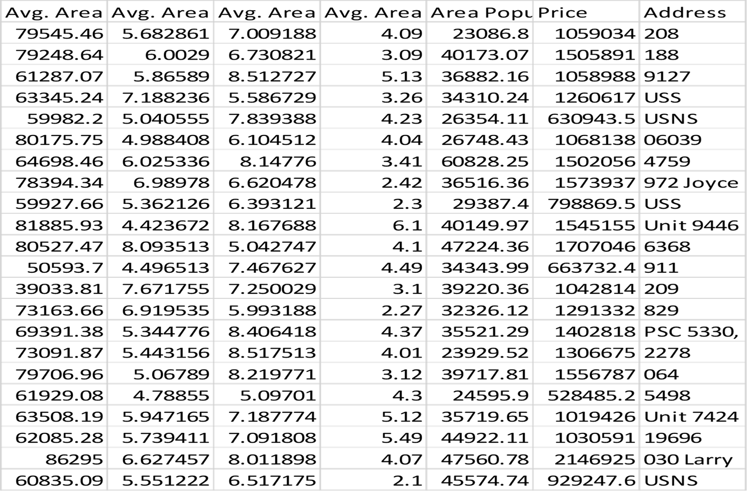
Output:

Slide 12

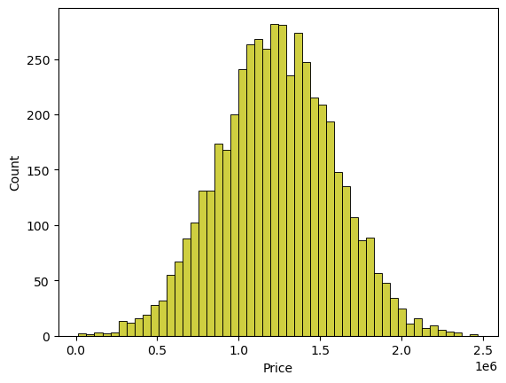
Preprocessing the dataset:
Data preprocessing is the process of cleaning,transforming,and integrating data in order to make it ready for analysis.
This may involve removing errors and inconsistencies,handling missing values,transforming the data into a consistent format,and scaling the data to a suitable range.
Visualisation and Pre-Processing of Data
IN[1]:
sns.histplot(dataset, x='Price', bins=50, color='y')
OUT[1]:
<Axes: xlabel='Price', ylabel='Count'>

Slide 13
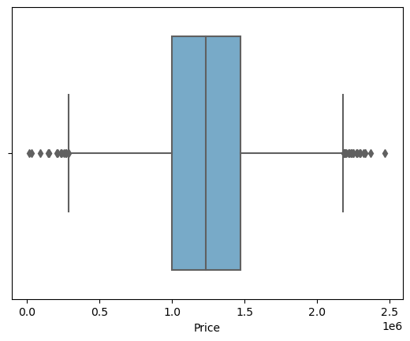
IN[2]:
sns.boxplot(dataset, x='Price', palette='Blues')
OUT[2]:
<Axes: xlabel='Price'>
IN[3]:
sns.jointplot(dataset, x='Avg. Area House Age', y='Price', kind='hex')
OUT[3]:
<seaborn.axisgrid.JointGrid at 0x7dbe246100a0>

Slide 14
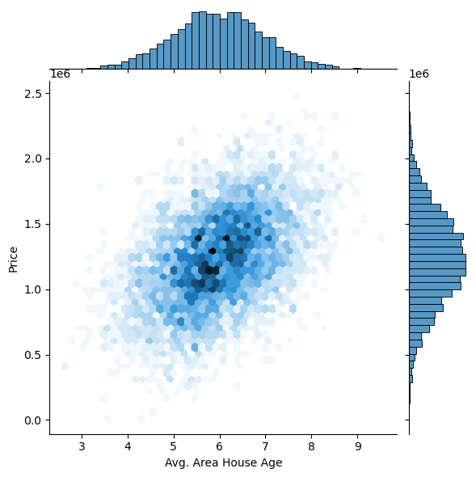
IN[4]:
sns.jointplot(dataset, x='Avg. Area Income', y='Price')
OUT[4]:
<seaborn.axisgrid.JointGrid at 0x7dbe1333c250>

Slide 15
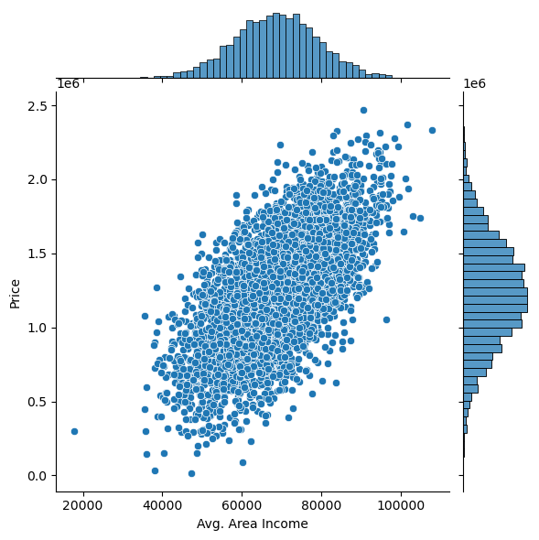
IN[5]:
plt.figure(figsize=(12,8))
sns.pairplot(dataset)
OUT[5]:
<seaborn.axisgrid.PairGrid at 0x7dbe1333c340>

Slide 16
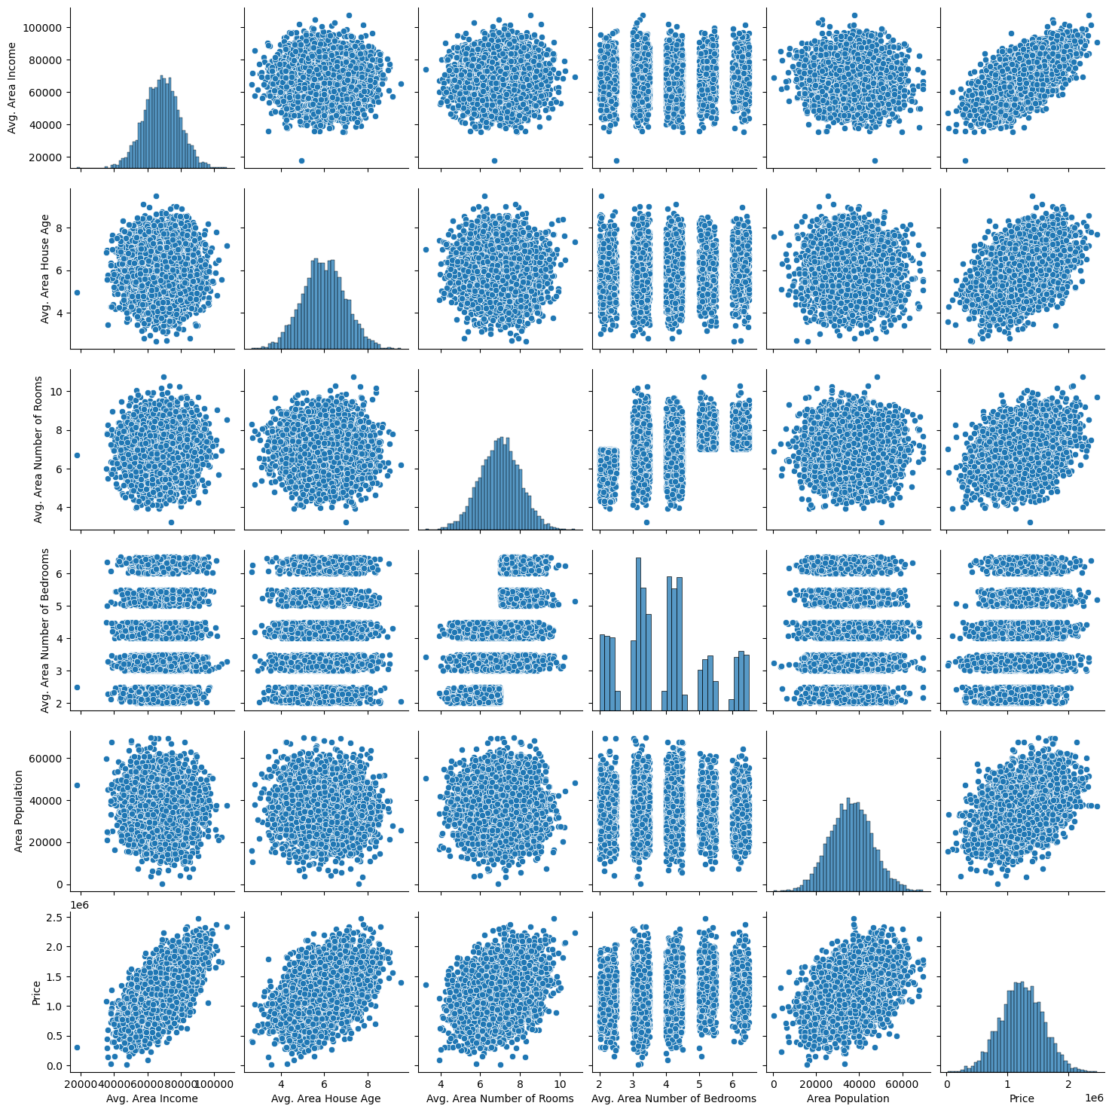
IN[6]:
dataset.hist(figsize=(10,8))
OUT[6]:
array([[<Axes: title={'center': 'Avg. Area Income'}>,
<Axes: title={'center': 'Avg. Area House Age'}>],
[<Axes: title={'center': 'Avg. Area Number of Rooms'}>,
<Axes: title={'center': 'Avg. Area Number of Bedrooms'}>],
[<Axes: title={'center': 'Area Population'}>,
<Axes: title={'center': 'Price'}>]], dtype=object)

Slide 17
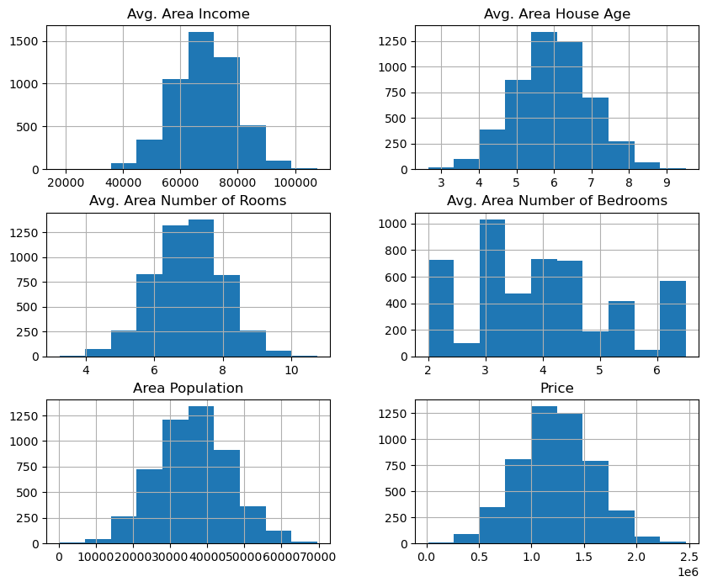
Visualising Correlation
IN[7]:
dataset.corr(numeric_only=True)

Slide 18
OUT[7]:
IN[8]:
plt.figure(figsize=(10,5))
sns.heatmap(dataset.corr(numeric_only = True), annot=True)
OUT[8]:
<Axes: >

Slide 19
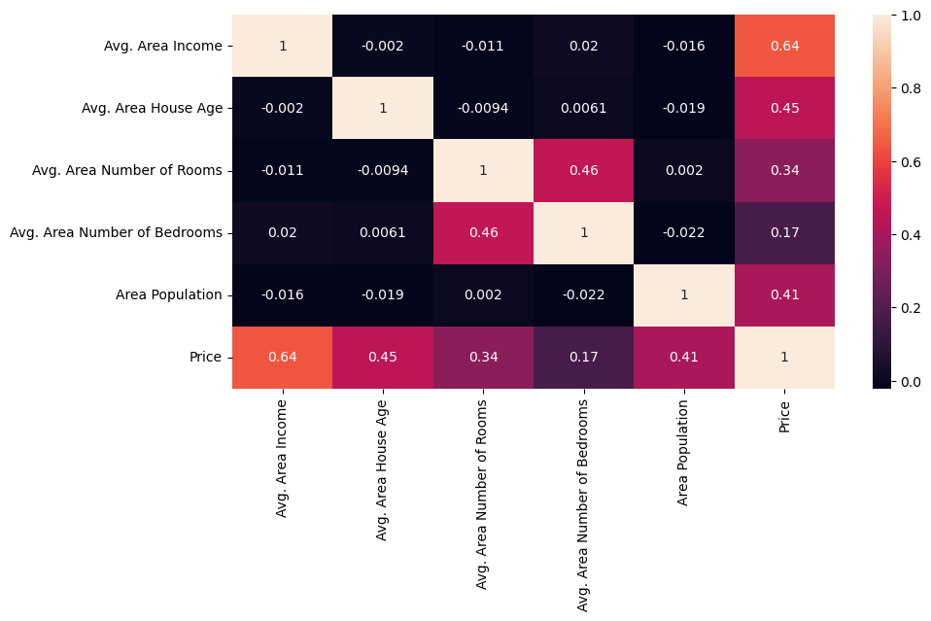

Slide 20

Conclution:
In the quest to build a house price prediction model,we have embarked on a critical journey that begins with loading and preprocessing the dataset.We have traversed through essential steps,starting with importing the necessary libraries to facilitate data manipulation and analysis.
Understanding the data’s structure,characteristics,and any potential issues through exploratory data analysis(EDA)is essential for informed decision-making.
Data preprocessin emerged as a pivotal aspect of this process.It involves cleaning,transforming,and refining the dataset to ensure that it aligns with the requirements of machine learning algorithm .
With these foundation steps completed,our dataset is now primed for the subsequent stages of building and training a house price prediction model.

